Slide 1
Market & retail Analysis
Gaurav Sawant

Slide 2

Agenda
Objective
Background
What The Data Shows
Recommendations
Data Methodology

Slide 3

Objective
To analyze Olist e-commerce dataset
To help Olist reduce their losses by helping them on cutting down unnecessary inventory cost
To identify top products contributing to their revenue and use Market Basket Analysis to identify Individual Product Categories and combinations that can help with Sales Improvement

Slide 4
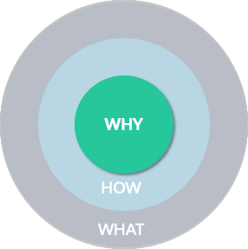
Background
How does an e-commerce company offer “wide variety of options or products”? To be able to meet the demands of the customers, e-commerce company needs to store tons and tons of products in warehouses. Each of the products being stored incurs a cost to the company in terms of space and maintenance. Since storing these products obviously add to the costs that the company incurs, it is necessary for the organizations to plan their inventory well.
Now, OList is one such e-commerce company that has faced some losses recently and they want to manage their inventory very well to reduce any unnecessary costs that they might be bearing.

Slide 5
What the data shows

Slide 6
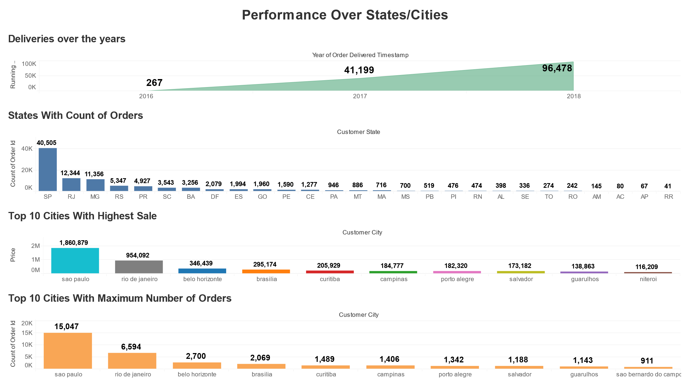
Performance Statistics

Slide 7
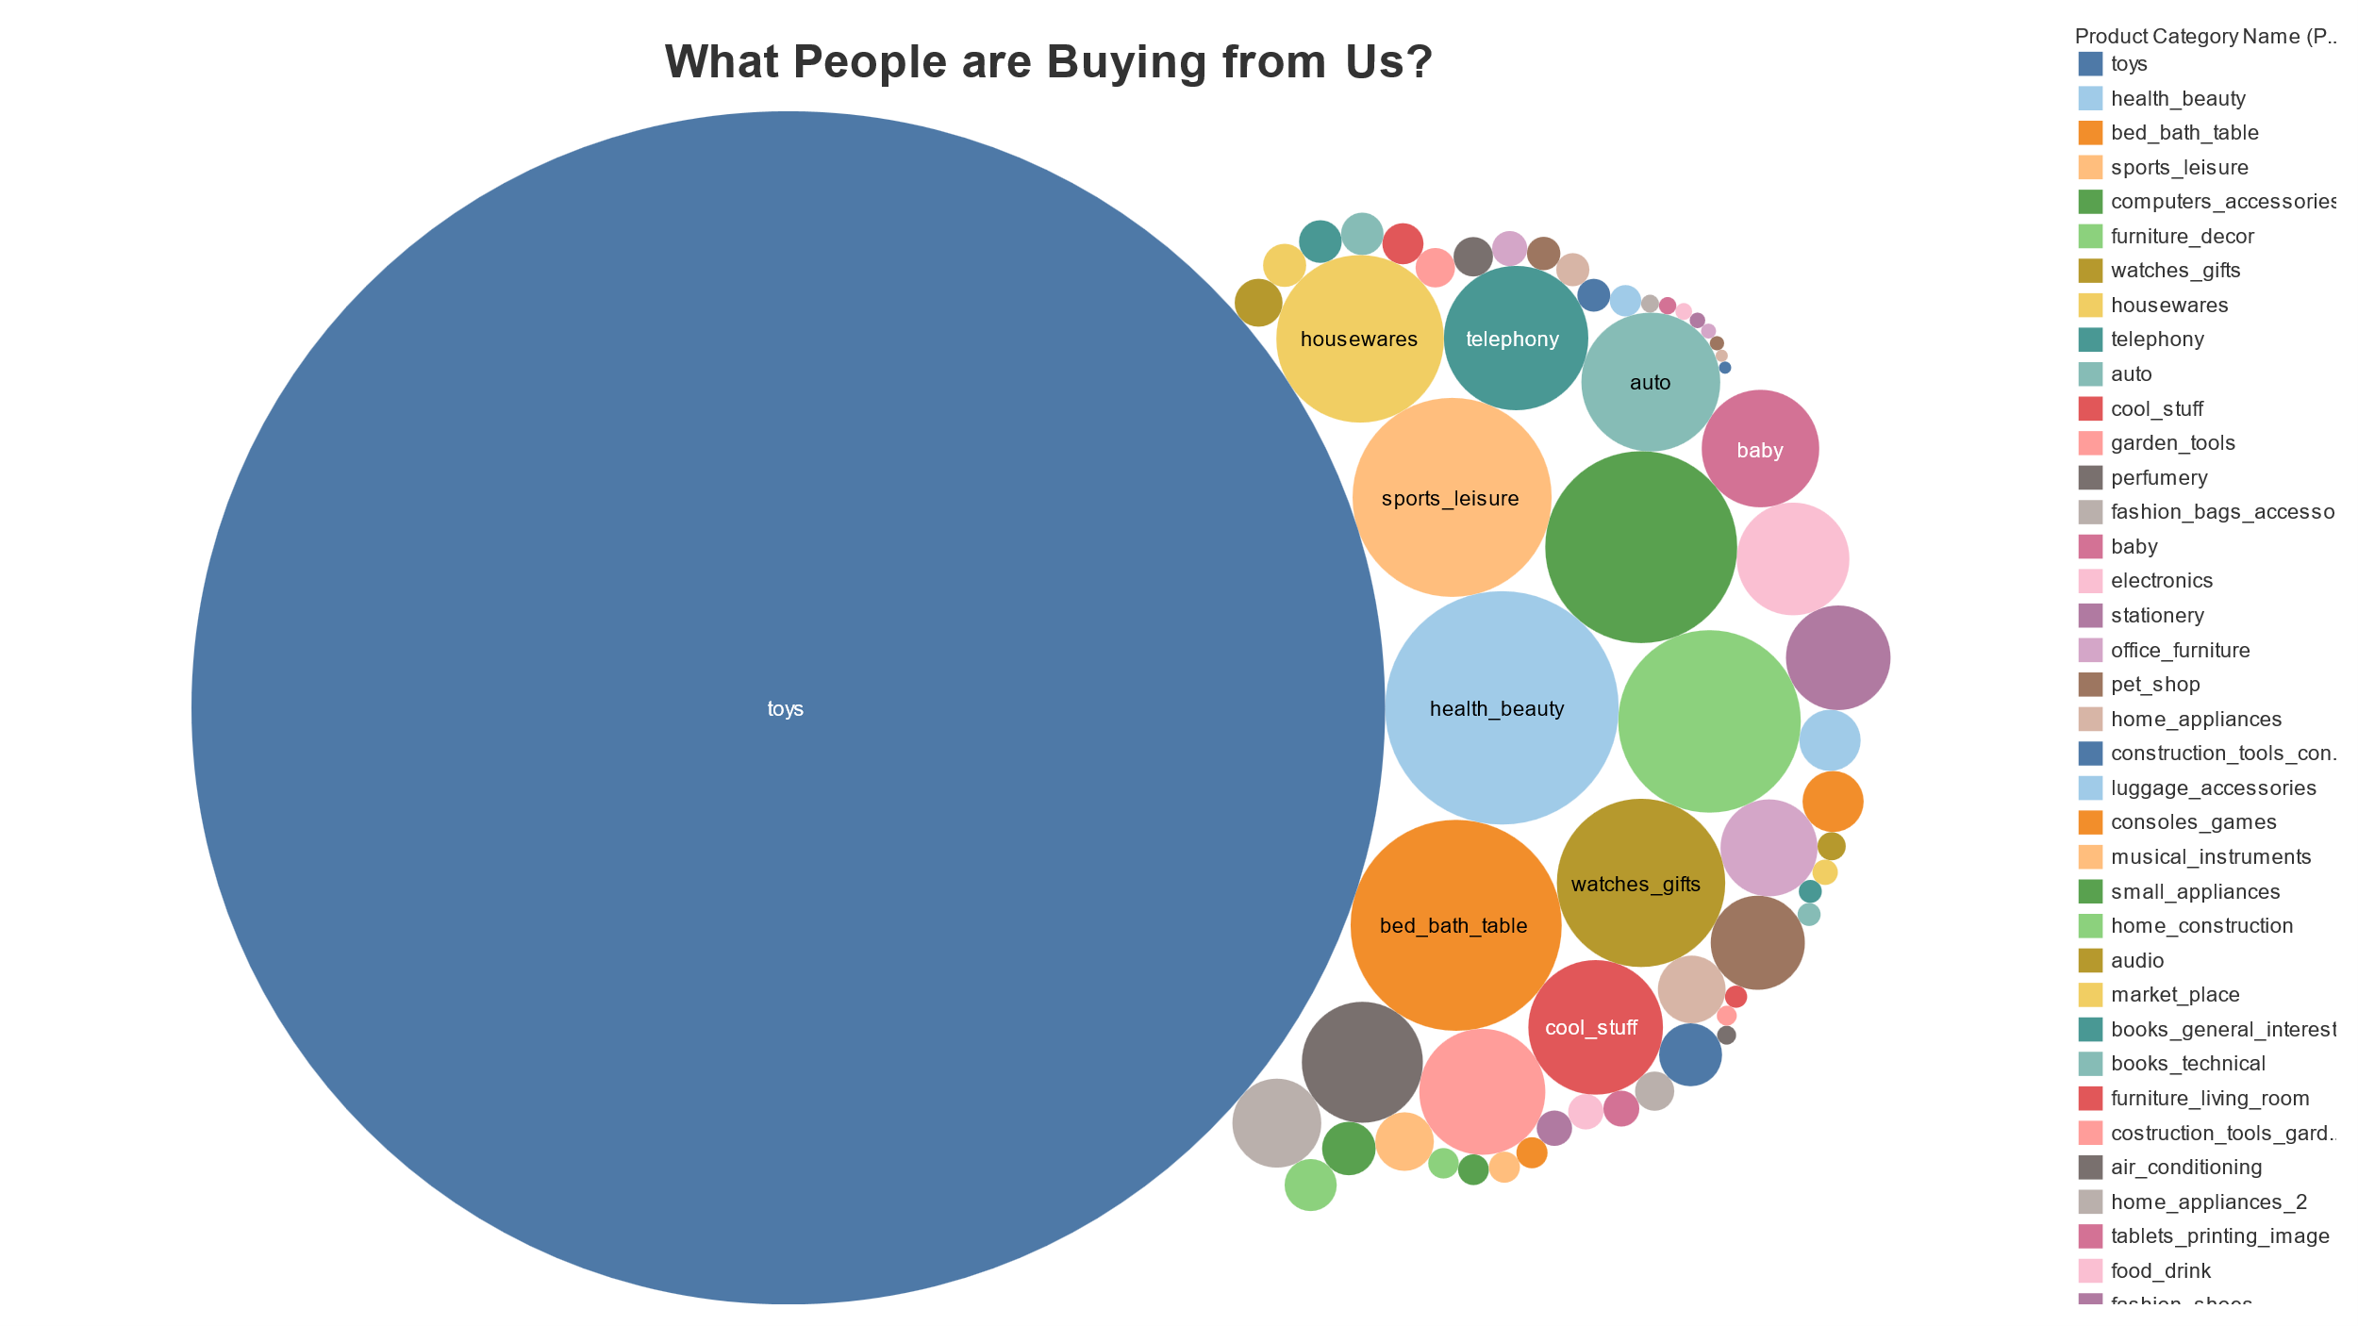
Product Categories ordered More than 5 times

Slide 8
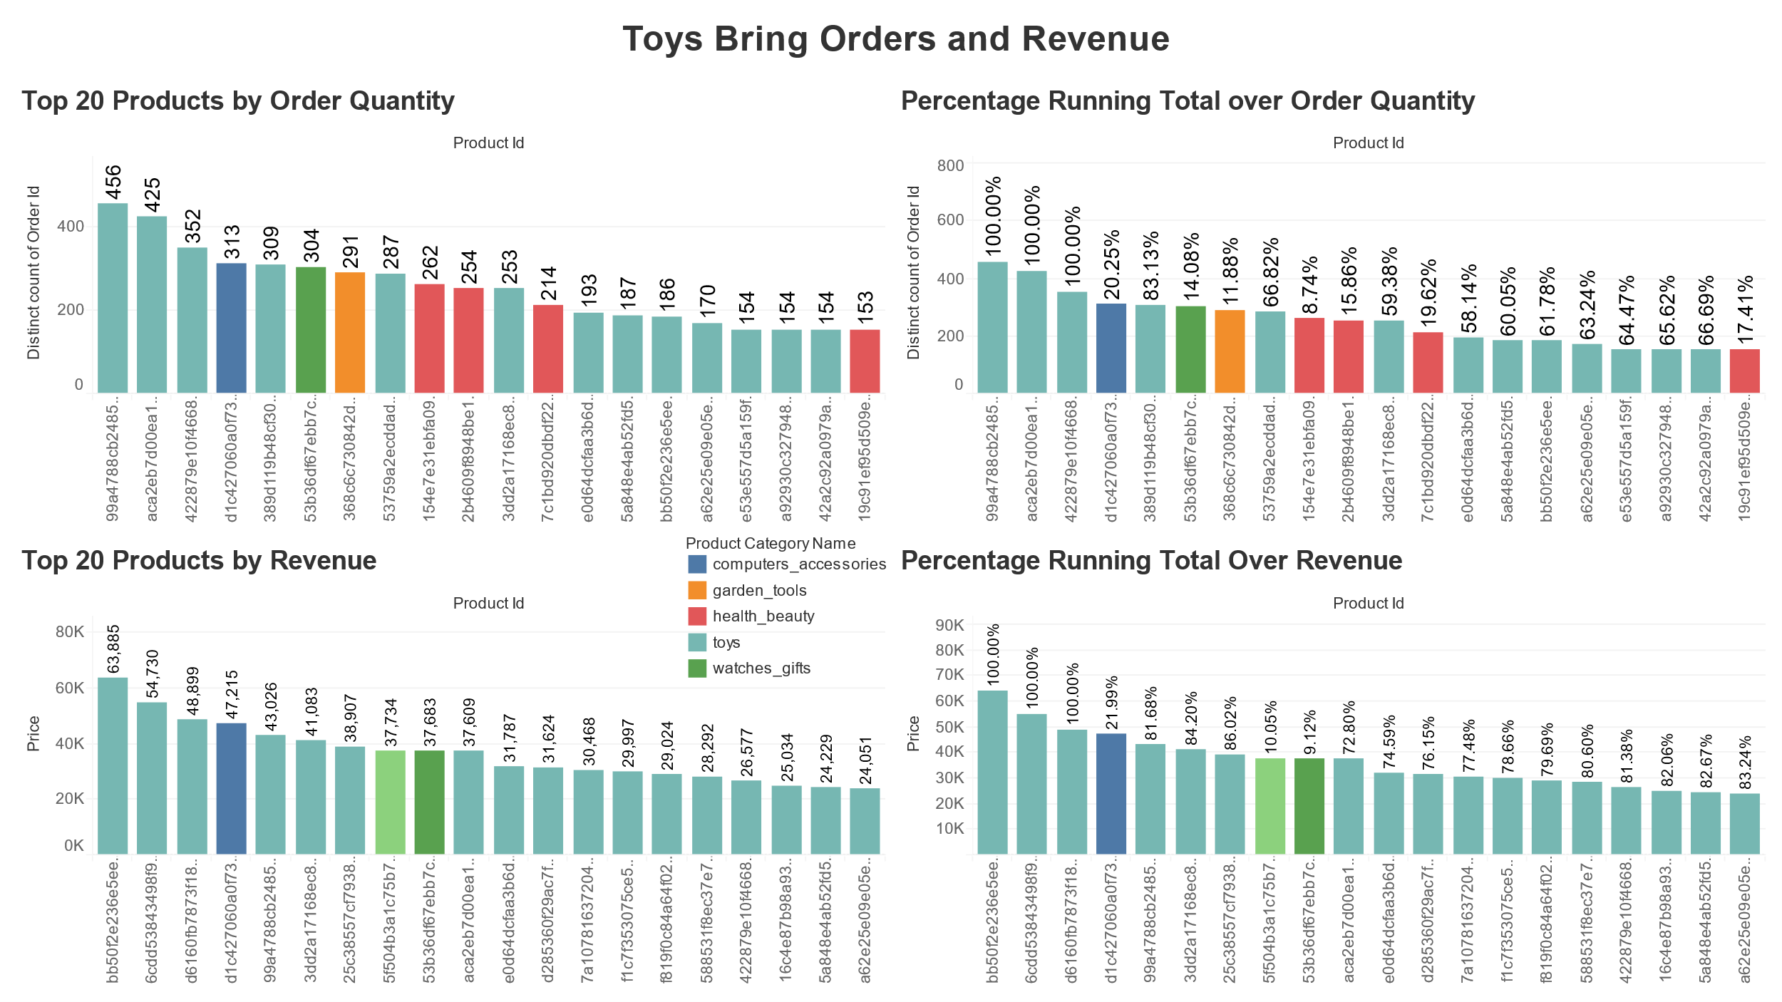
Statistics of Top 20 Products

Slide 9
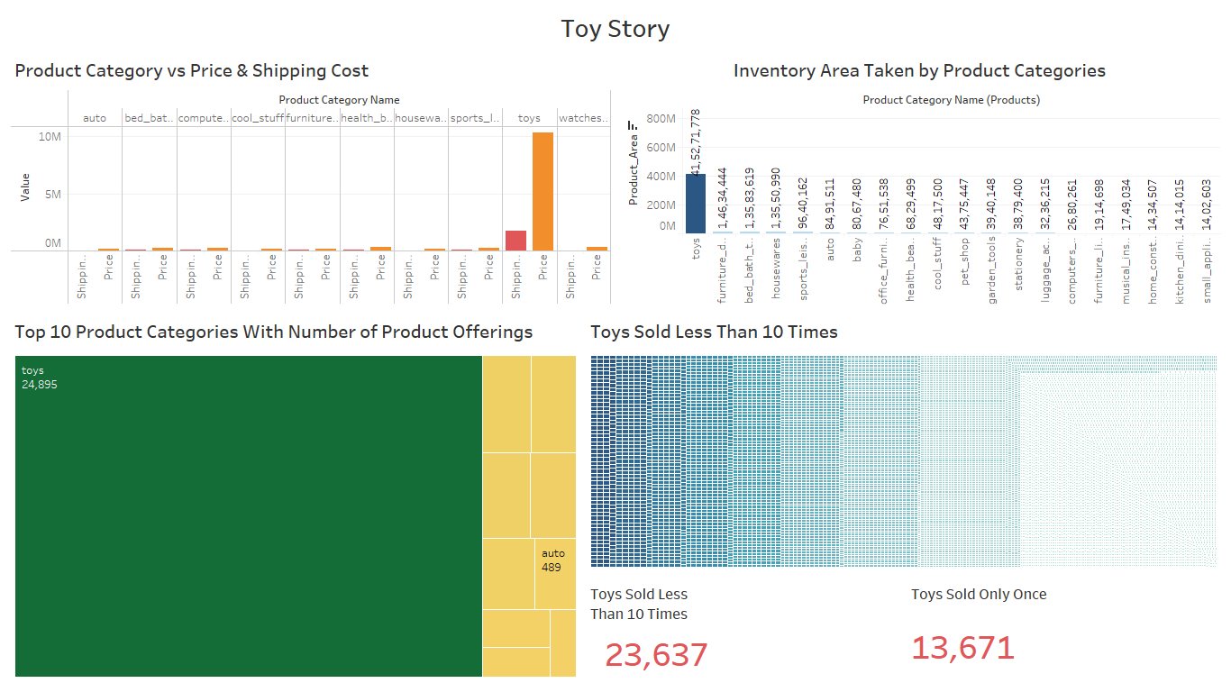
Product Category ['Toys']- Key Findings

Slide 10
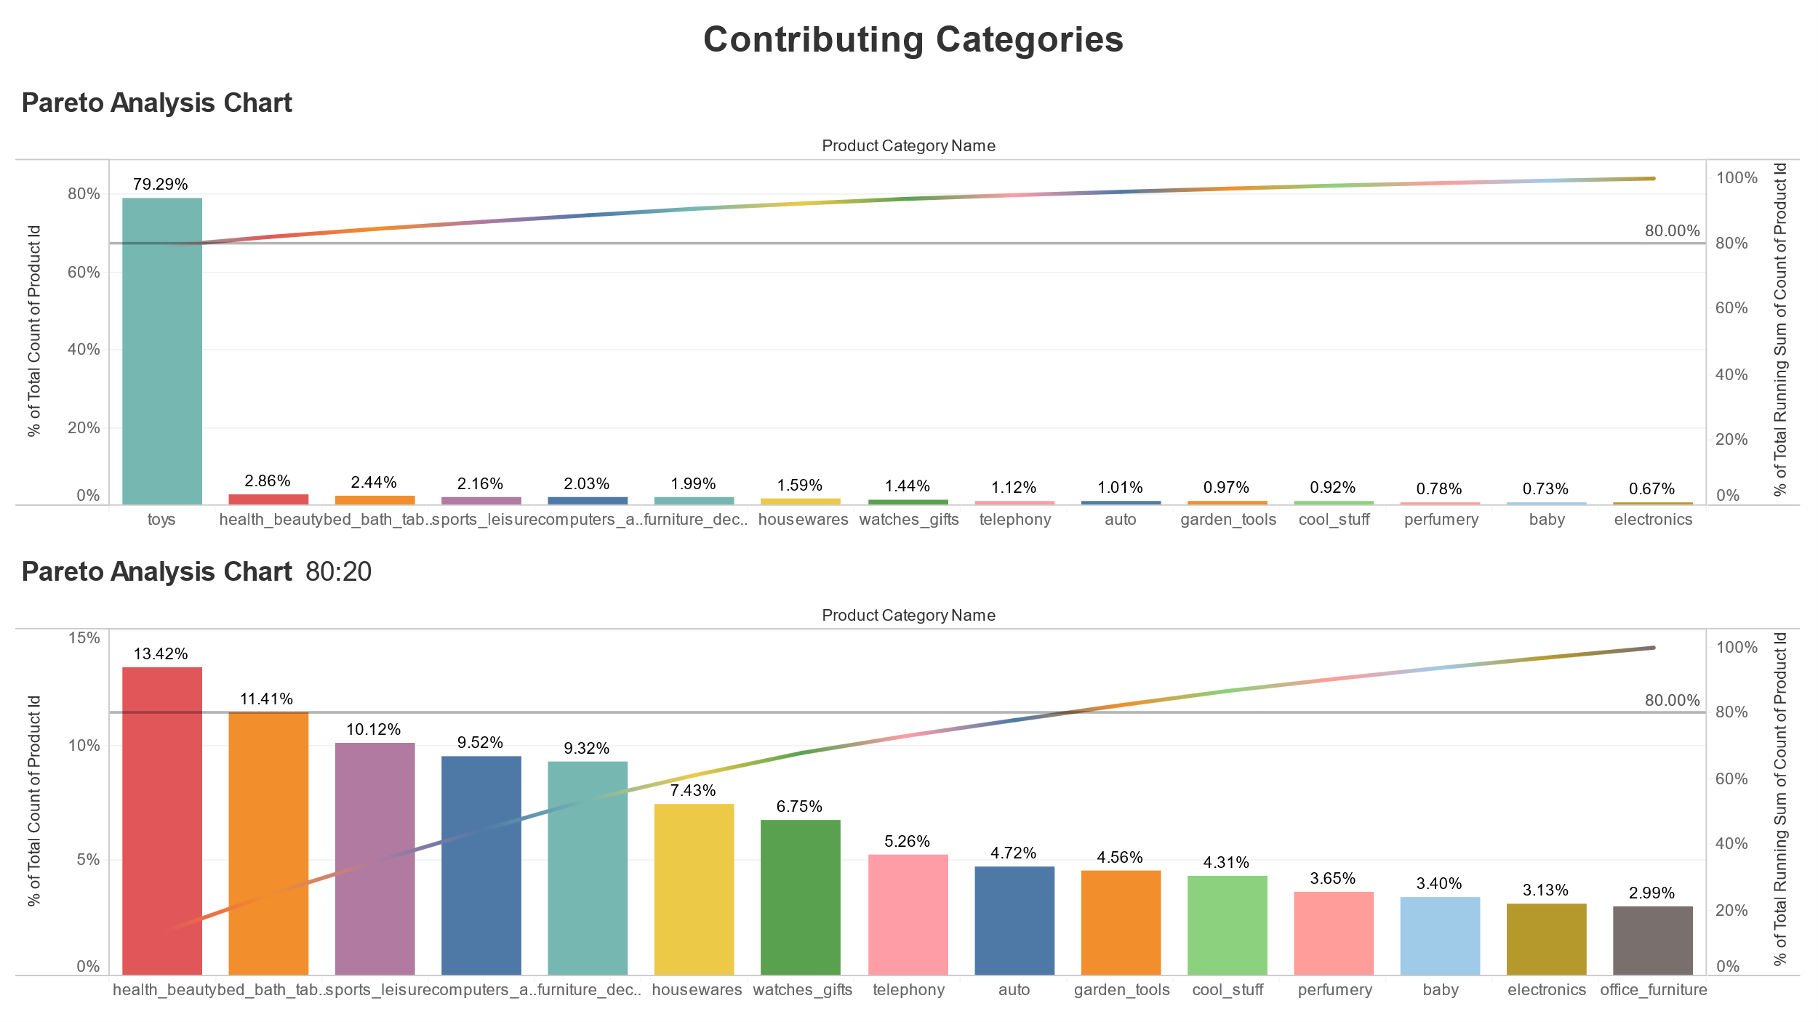
Pareto Analysis - Product Categories

Slide 11
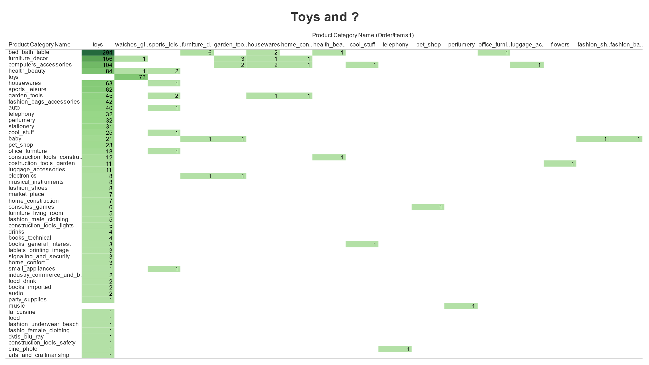
Market Basket Analysis

Slide 12
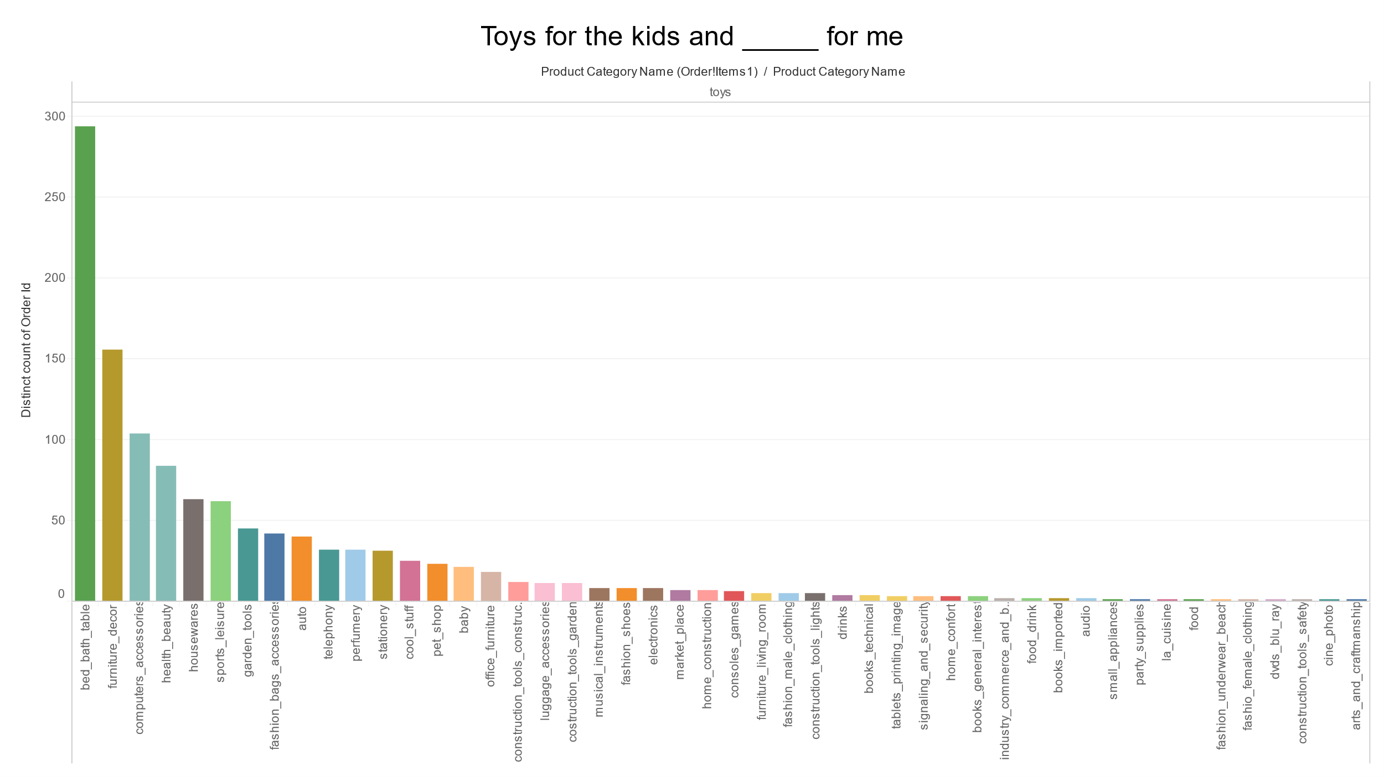
Market Basket Analysis - Toys

Slide 13
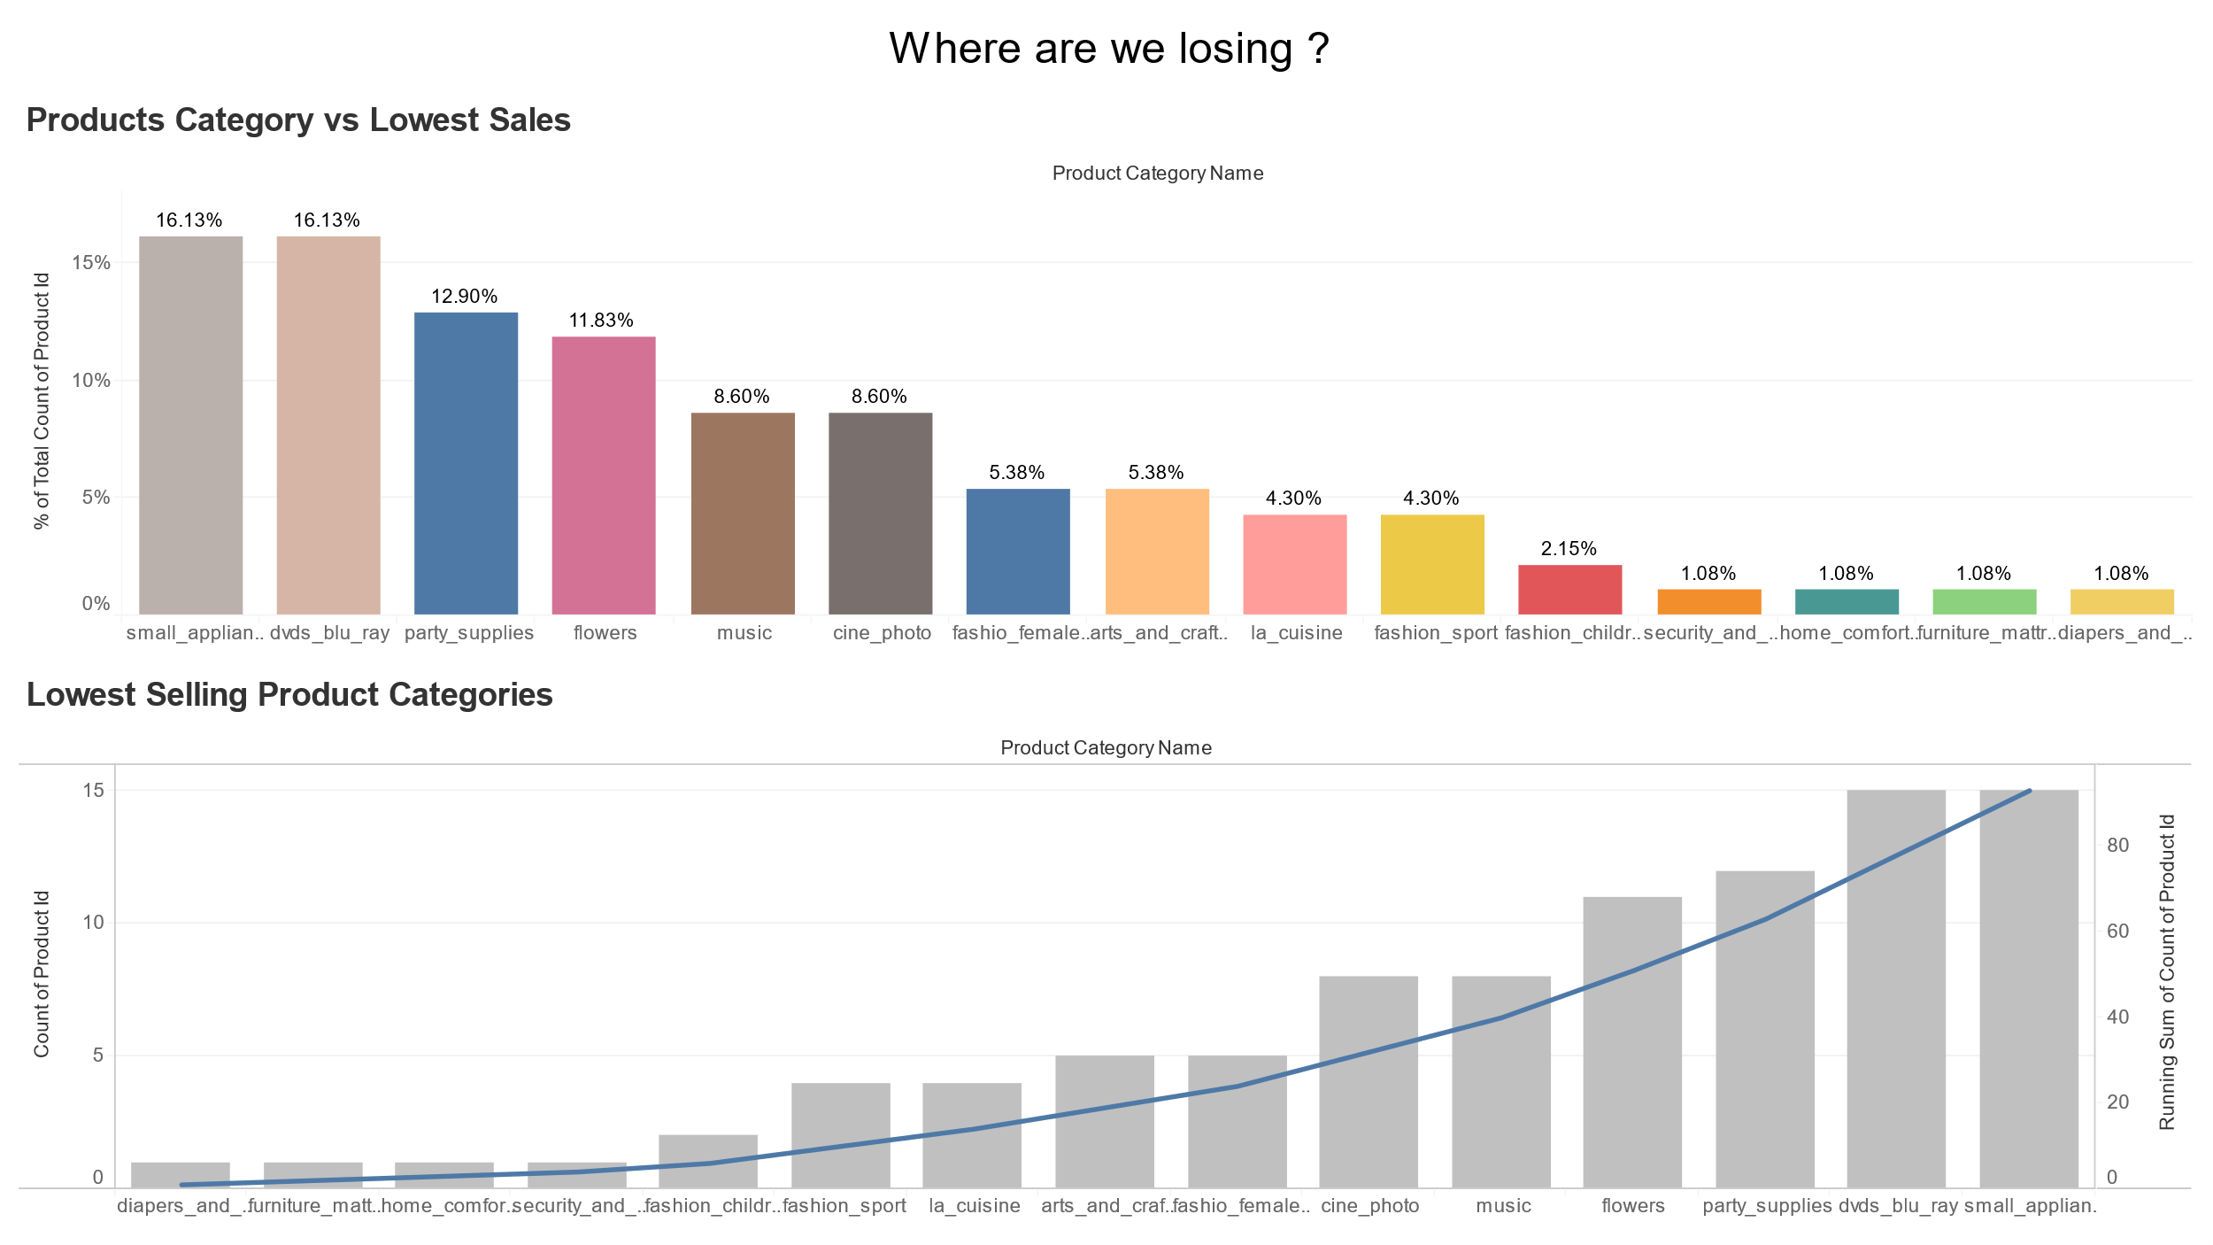
Lowest Contributing Product Categories

Slide 14
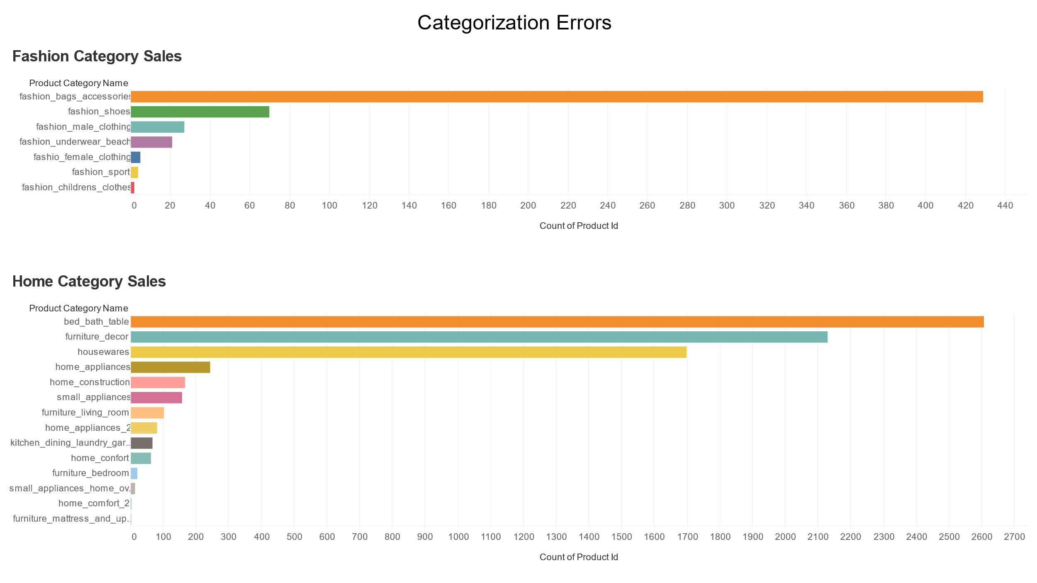
Category Classification Findings

Slide 15
Recommendations
1
Necessary Steps should be taken to improve the business in other States and Cities
2
In the category of Toys, the toys which are not sold frequently should be discarded, which are over 13,000
3
Apart from Toys the other Product Categories should be targeted as well as they are gaining the market slowly.
4
Products from Categories like Diapers, La Cuisine, Arts should be completely discarded along with the product category as they are not contributing to the market sale
5
Fashion & Home Categories are overly categorized. As a result, products form their categories are not gaining the customer’s attention. These categories should be combined for a better Basketing and Sale

Slide 16
Data Methodology
Data Cleaning
For products with no Product Category was considered as Toys by taking Mode of Product Categories
Data Extraction
The analysis was done on the ‘Delivered’ Orders
Data Insights
Used Tableau for the visualization purpose to get insights
Data Manipulation
Product Category was provided to product id in order_items sheet

Slide 17



Thank you
Gaurav Sawant

